Slide 1


Slide 2
Unjustified parking at parking spaces reserved for the disabled people through the perspective of social solidarity and anomie
assist. prof. Aleš Bučar Ručman, PhD
Faculty of Criminal Justice and Security, University of Mariboru

Slide 3
IDEA/MOTIVATION FOR RESEARCH
Surprise
Anger
Conclusion/
Speculation

Slide 4

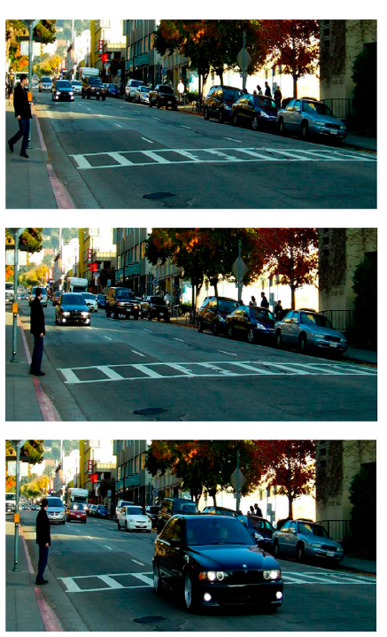
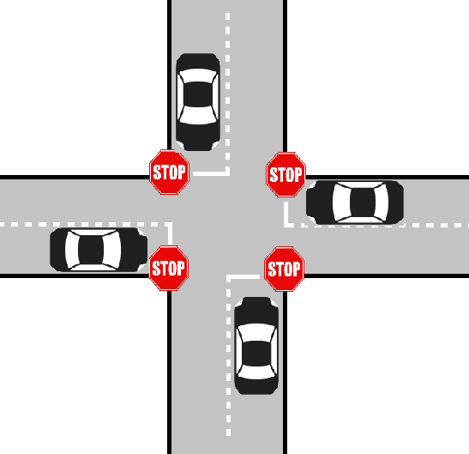


Theoretical background
The right to mobility and movement is a vital characteristic of freedom in Western societies. It is the “core to people’s identities, life experiences, and opportunities” (Imrie, 2000: 1641)
Higher social class predicts increased unethical behavior (2012); Paul K. Piff, Daniel M. Stancato, Stéphane Côté, Rodolfo Mendoza-Denton, and Dacher Keltner. Proceedings of the National Academy of Sciences of the USA, year 109, p. 4086-91.

Slide 5
»But I did not hinder anyone.«
»Disabled people also occupy sidewalks and other parking spots and they don’t get the ticket.«
»Where is the sign that prohibits parking for non-disabled people here?«
»If the place was crowded, I wouldn’t park here.«
»But it’s just for 5 minutes.«
»But I turned on all four signal lights!«
»I can park here for 5 minutes since I’m a journalist!«
»I do have the card for disabled people, but I‘ve given it to my grandmother.«
Selected excuses that were given to the municipal
wardens by offenders after parking on parking spaces for the disabled people.

Slide 6
INITIAL
RESEARCH
RQ
How do people respect the (moral & formal) norm, that parking at spaces reserved for disabled people is acceptable only for disabled badge holders?
Who is parking at spaces reserved for disabled people and what is happening at this parking spaces?
How can we connect this to other social phenomena, what can be concluded about the solidarity and anomie in Slovene society?

Slide 7
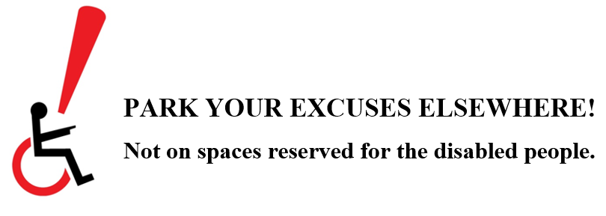
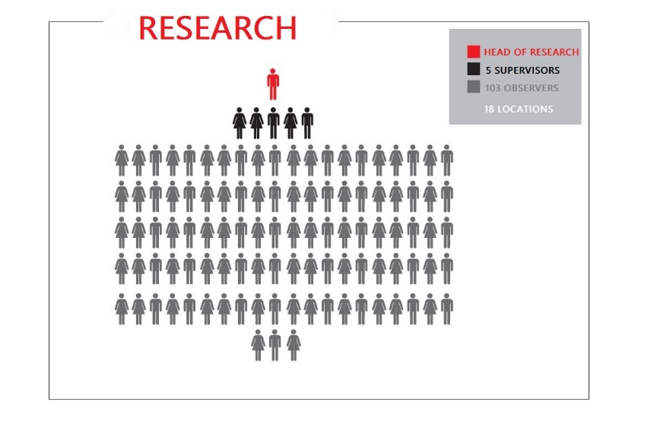
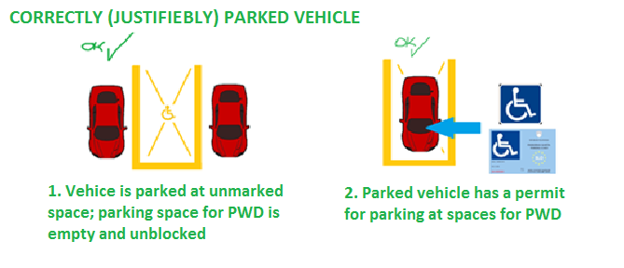
FIELD RESEARCH
  DAY 1: 17 April 2015; Friday; time: 14.00-18.00; weather: cloudy, a little rain (drizzle); 14ºC
  DAY 2: 18 April 2015; Saturday; time: 10.00-14.00; rainy all day; 4 ^{O}C
  Day 3: 21 April 2015; Tuesday; time: 14.00-18.00; sunny, 23ºC
Pre-research observation of parking spaces (28/3/2015; 11/4/2015);
Training of supervisors (5) => training of observers => conducting a research
Checking legal grounds at Information commissioner office; getting approval for research at private places

Slide 8
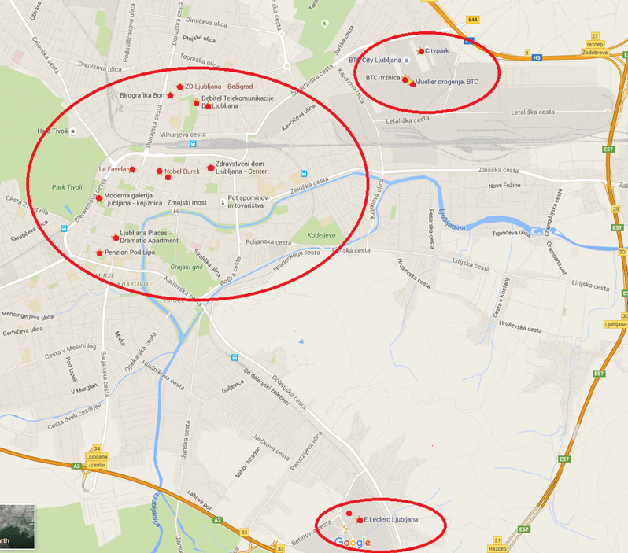
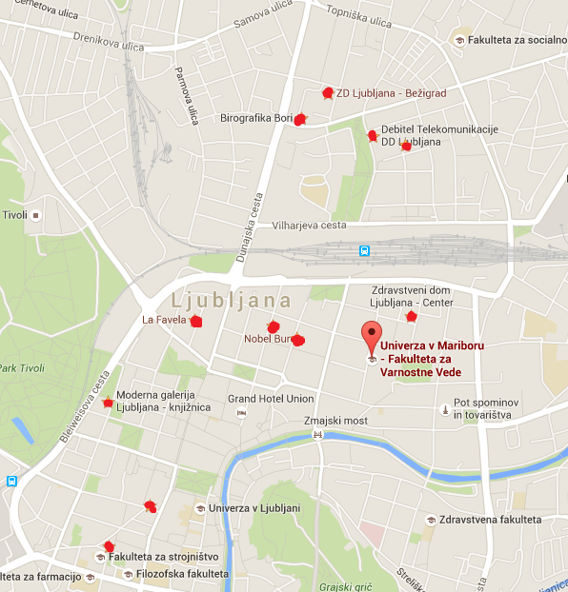
OBSERVED LOCATIONS
Shopping centres/malls, streets in the centre of Ljubljana, Community Health Centres

Slide 9
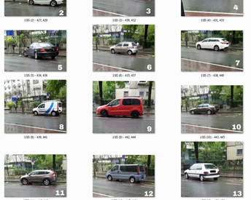
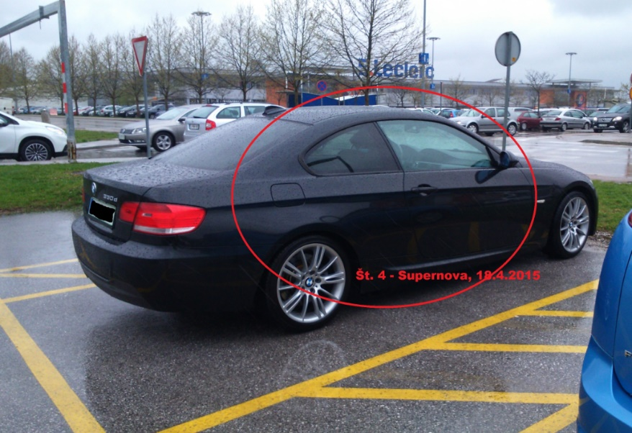
RESULTS OF THE STUDY

Slide 10
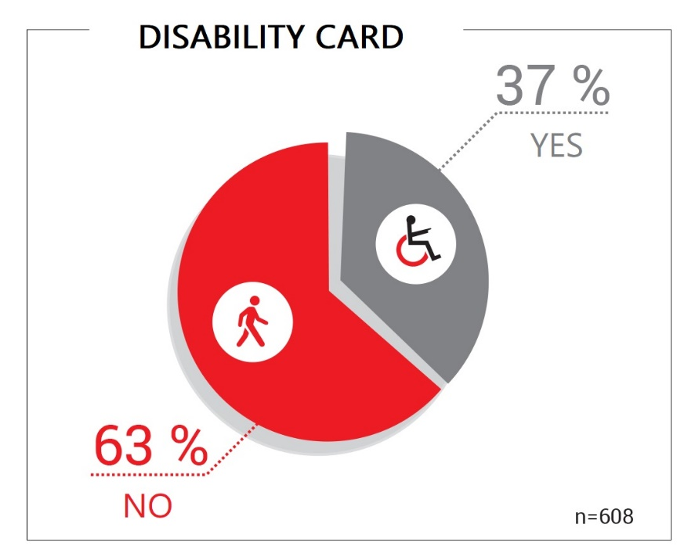
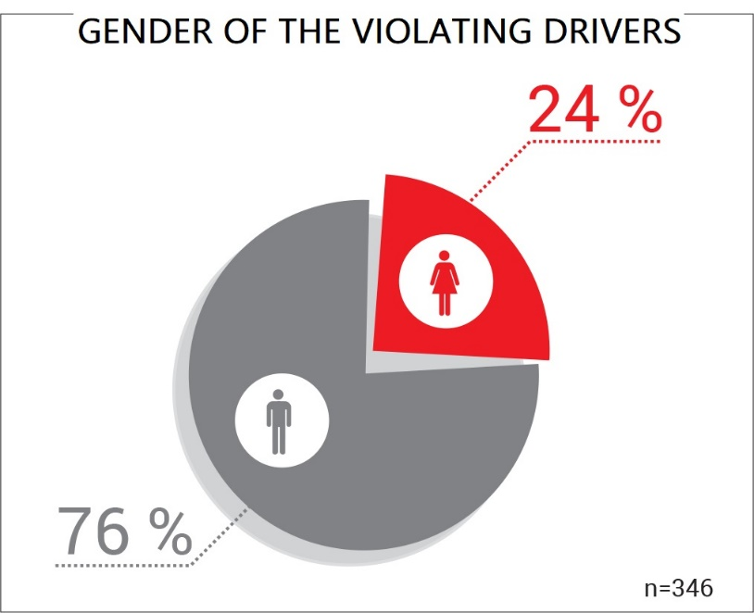
We gathered data 608 vehicles, which parked at parking spaces reserved for disabled badge holders only.
How many of them had disabled badge?
(n= 225)
(n= 383)
Data from research vs. official statistic (0 & 38,5%).

Slide 11
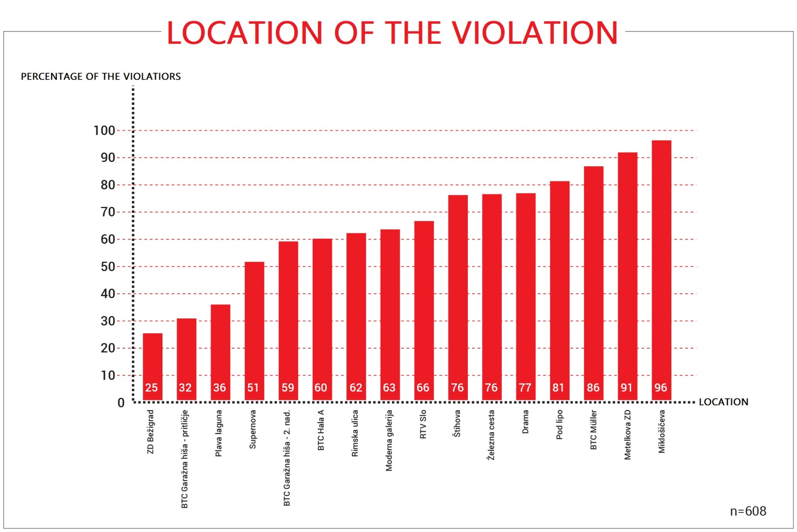

Slide 12
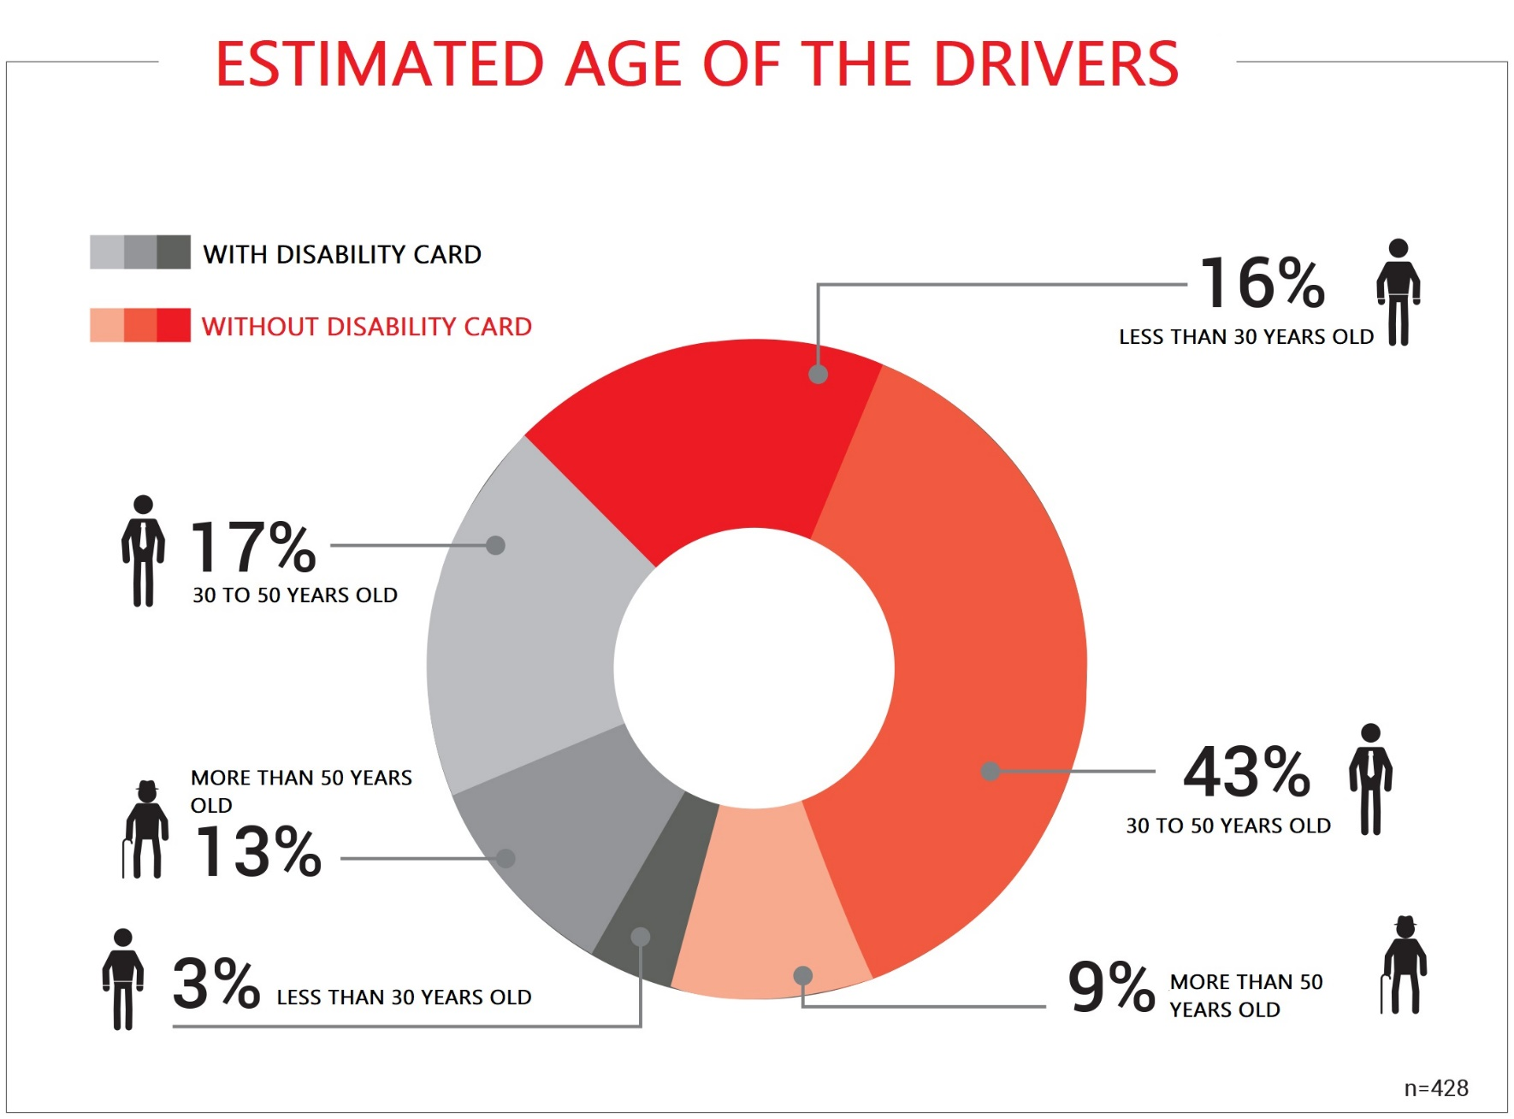

Slide 13
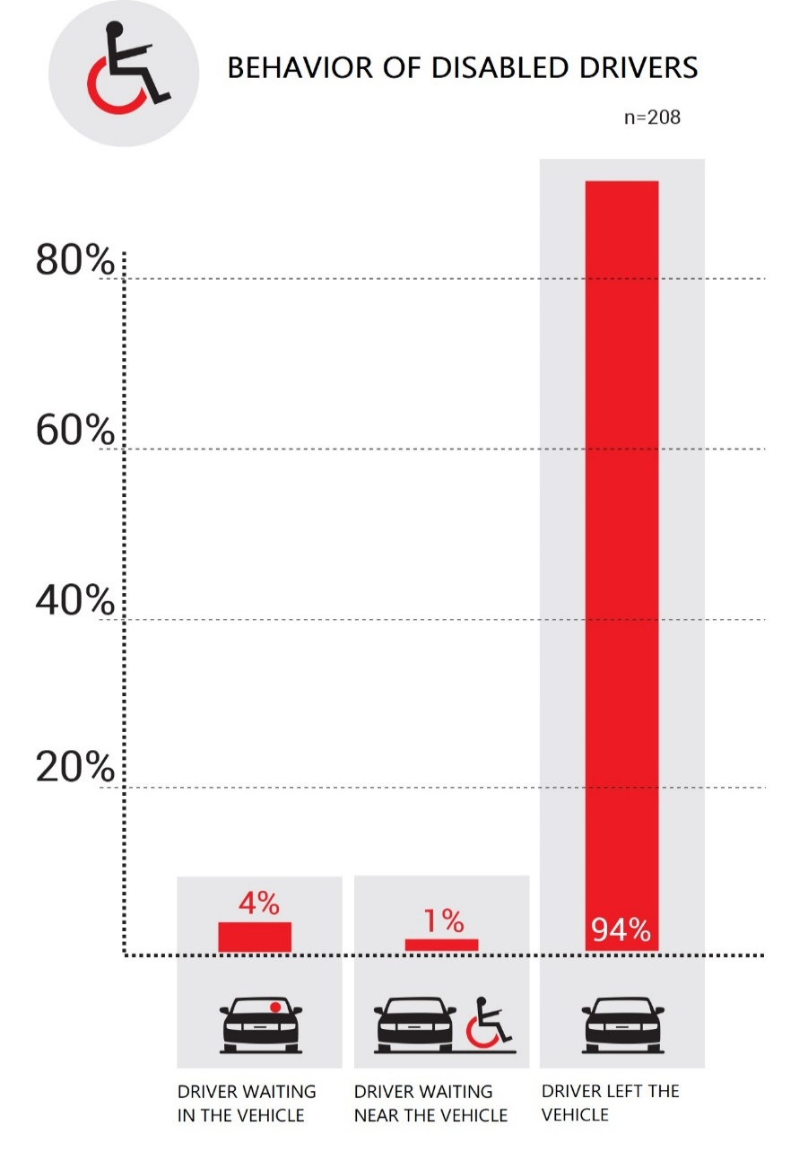
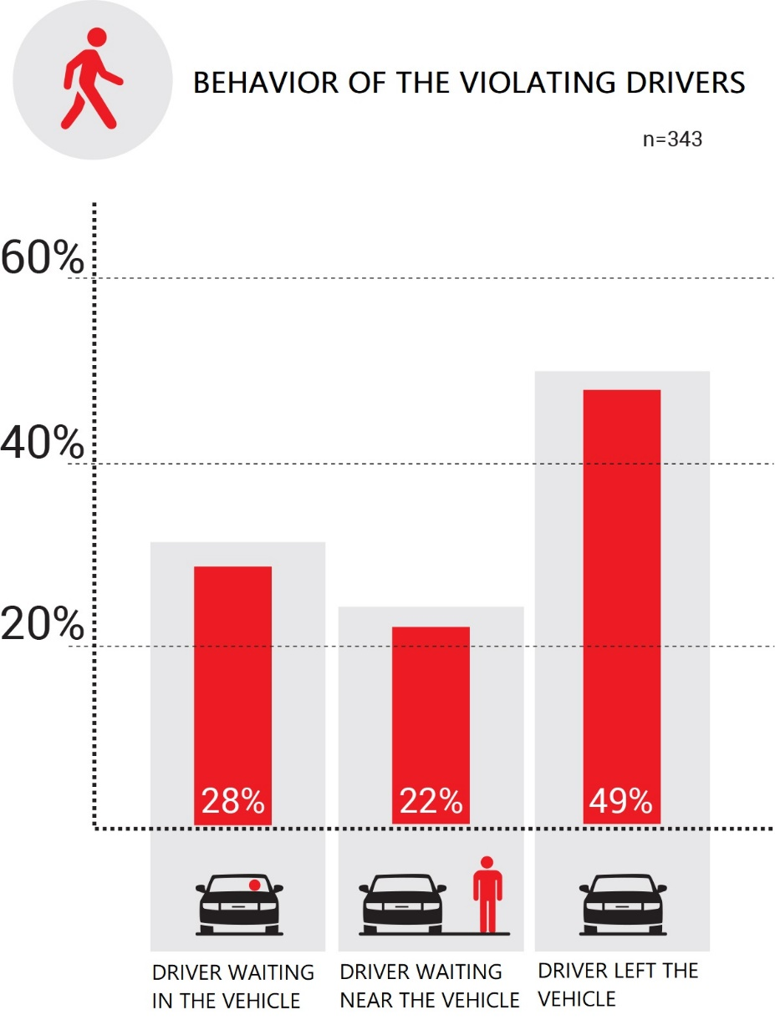

Slide 14
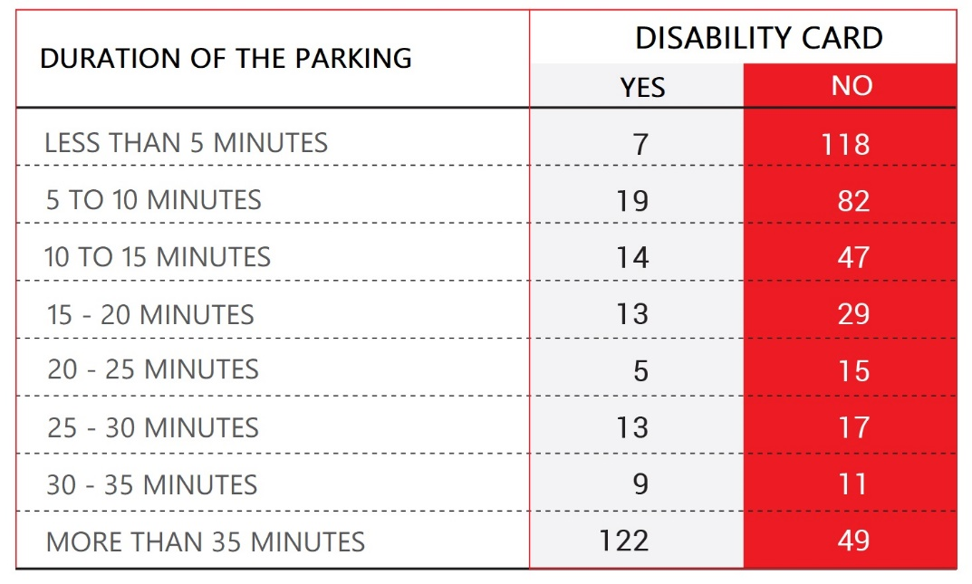

Slide 15
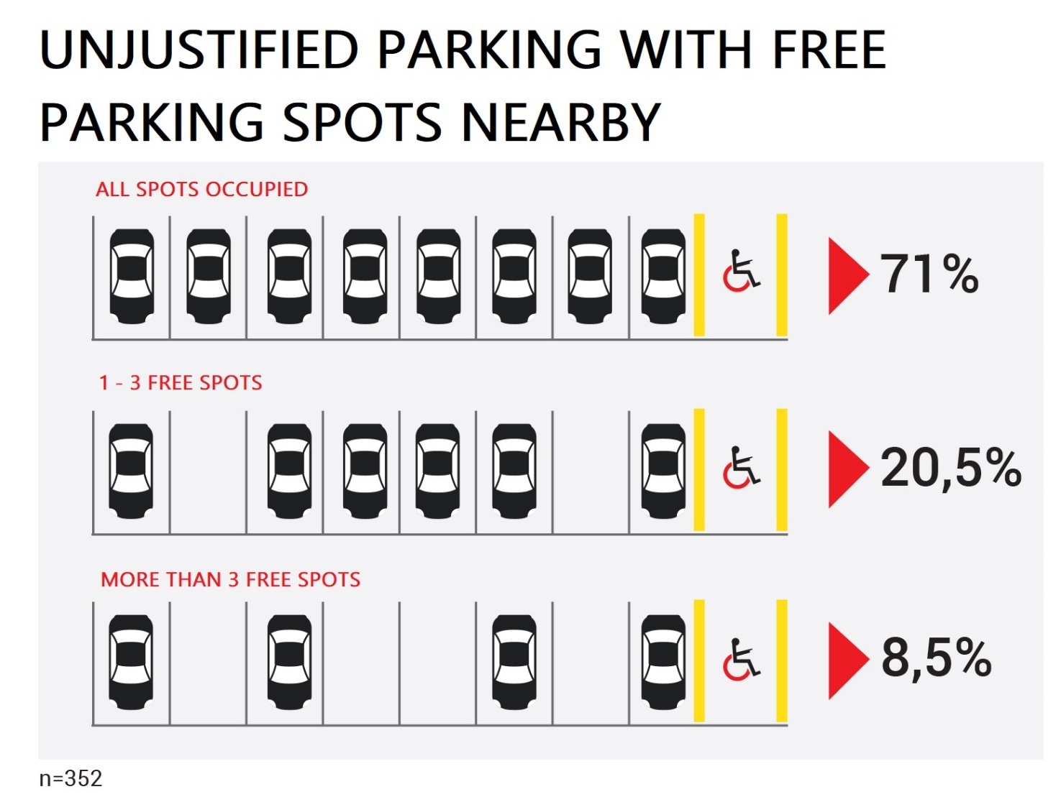
29 % drivers parked on the reserved space, although there were other free non-reserved spaces

Slide 16
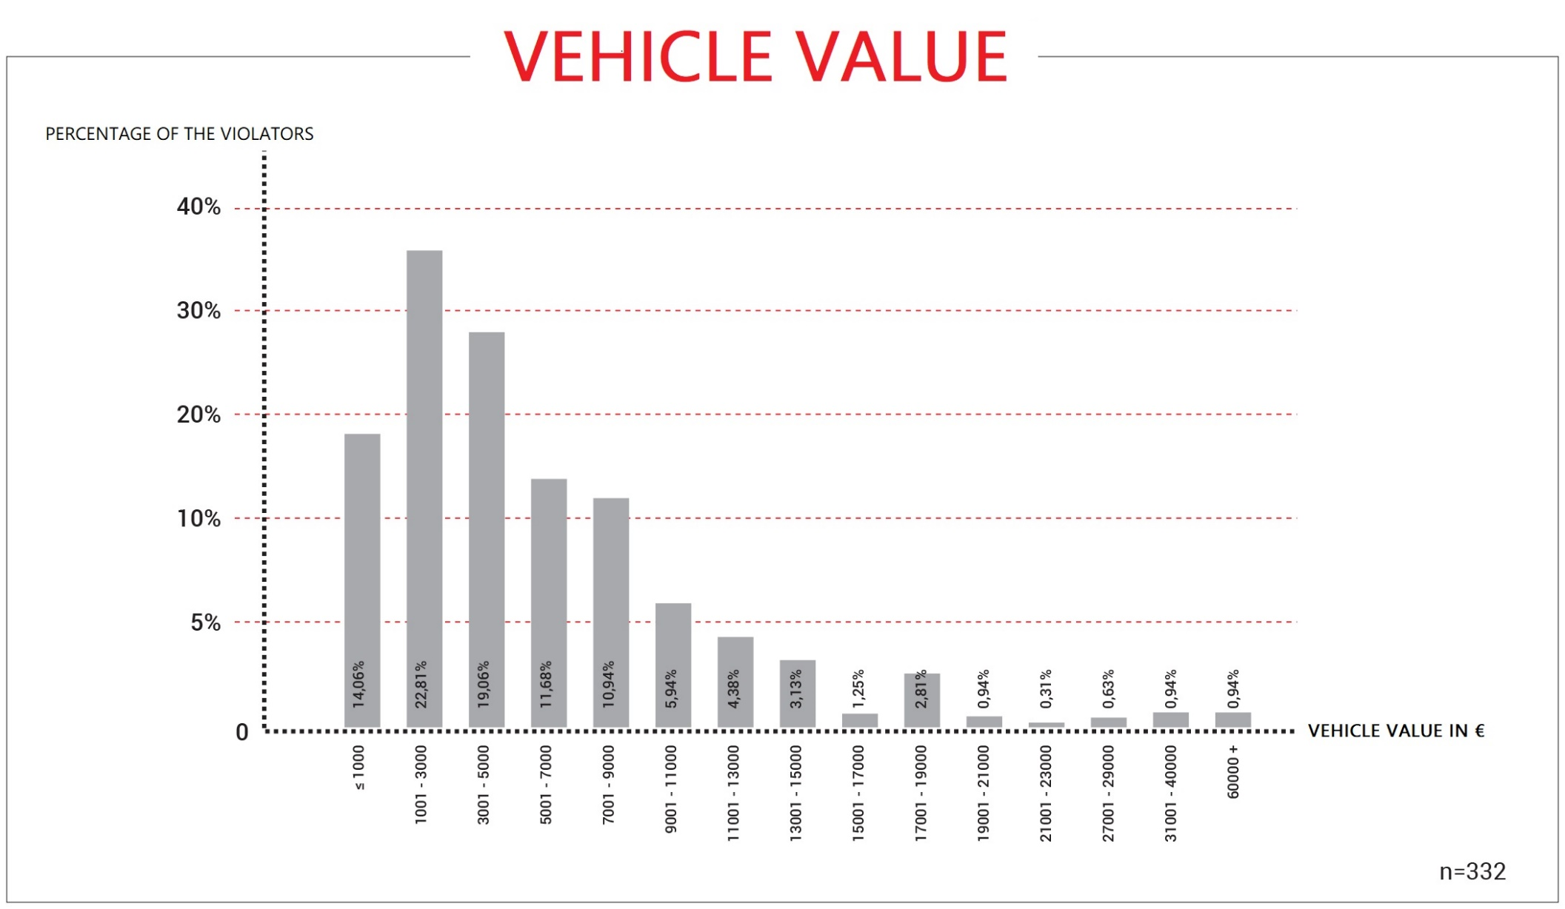
*
*Vehicle value was estimated by Stojan Renčelj, court expert in the field of car engineering

Slide 17


Slide 18

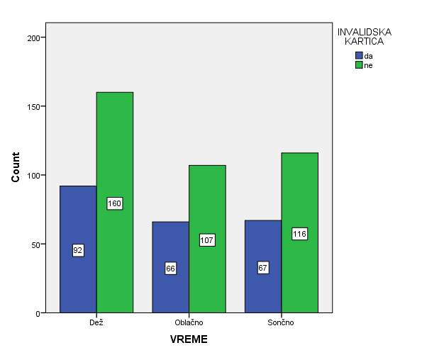
97,8 % violations with Slovenian licence plates
Weather

Slide 19
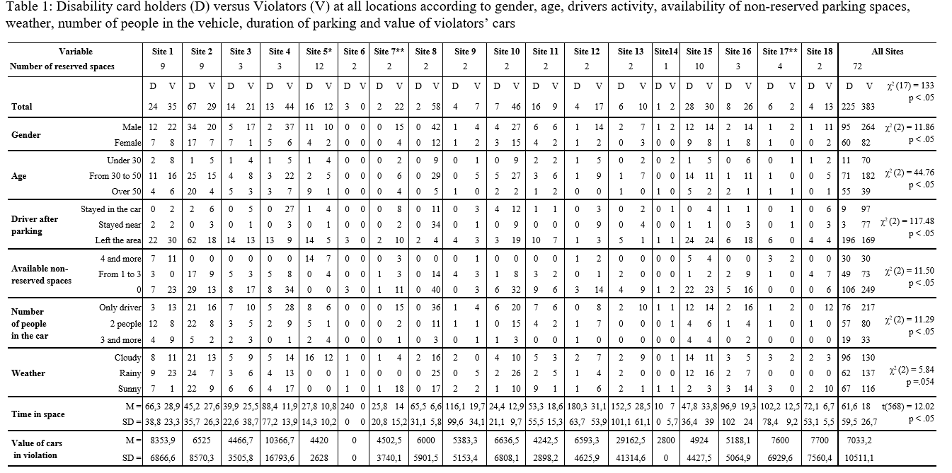

Slide 20






PROJECT
RESEARCH
EXPERT MEETINGS
PUBLIC
AWARENESS
CAMPAIGN
PARTNERS
SUPPORTERS
Notes:
cerabral palsy; blind and visually impaired;

Slide 21
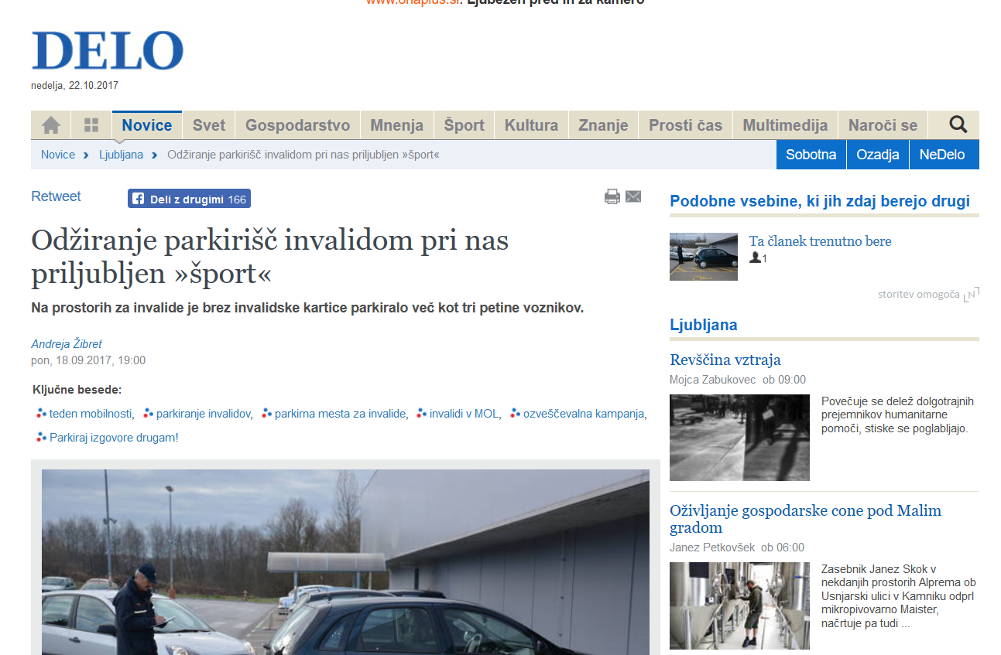
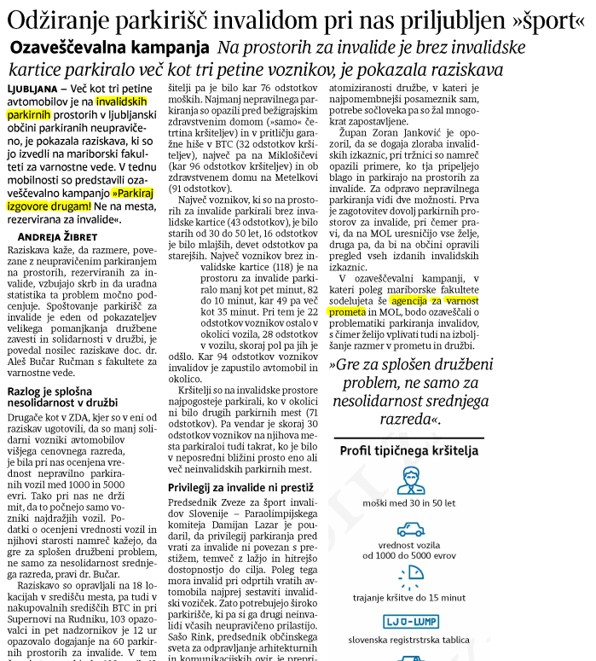
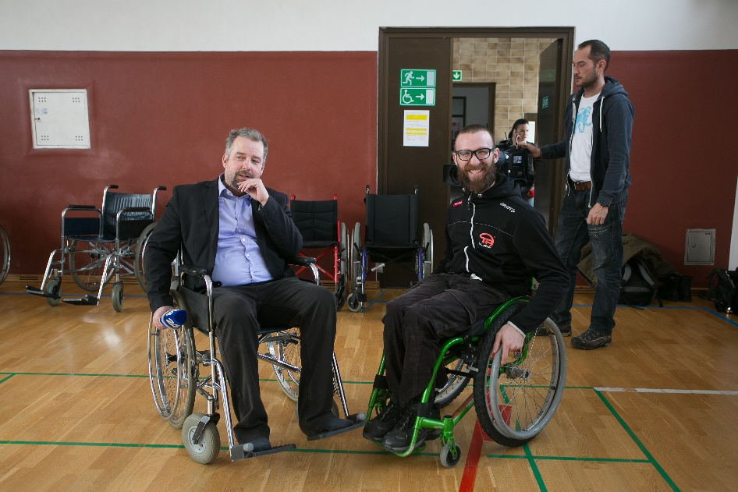
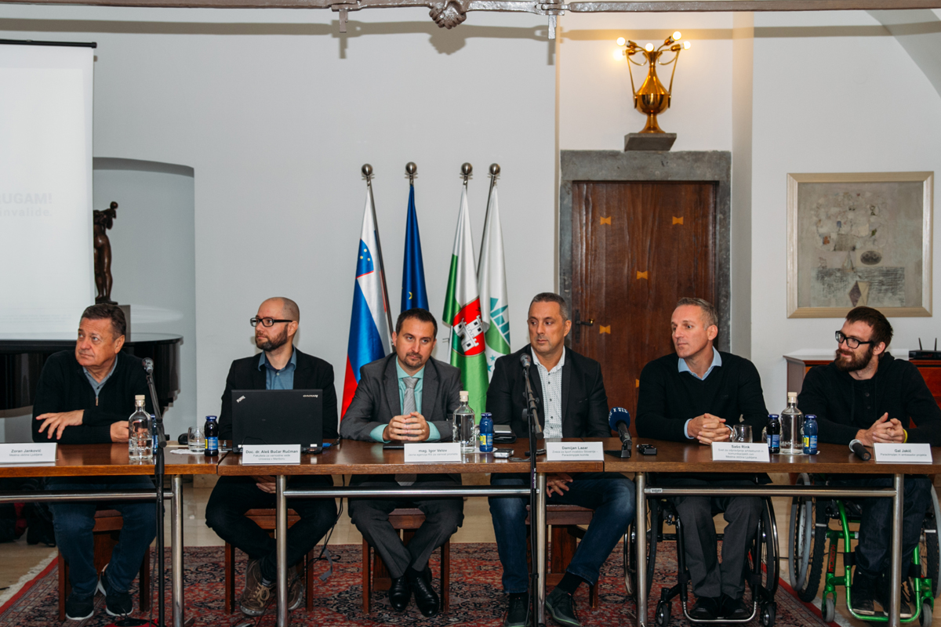
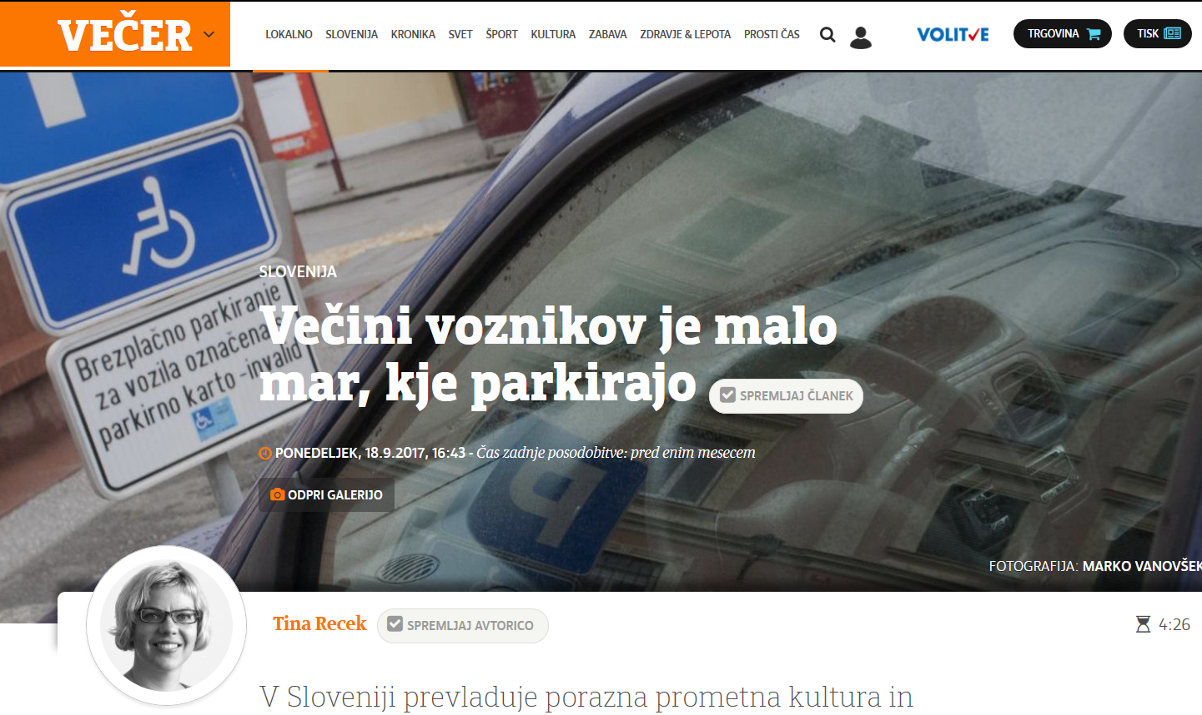
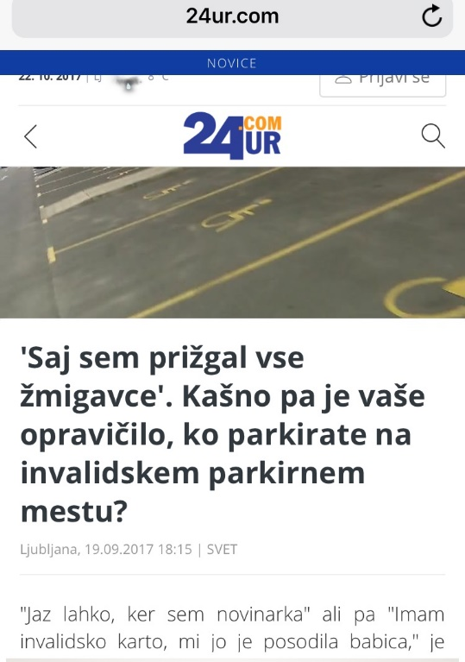
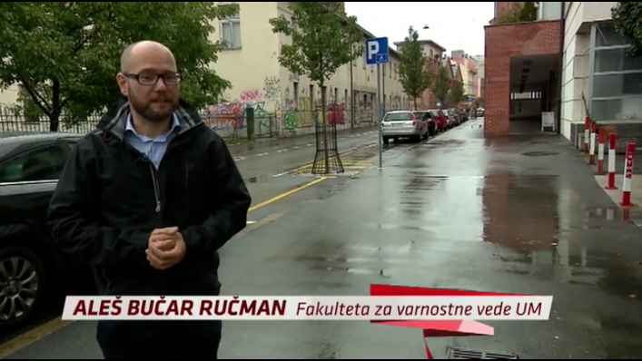
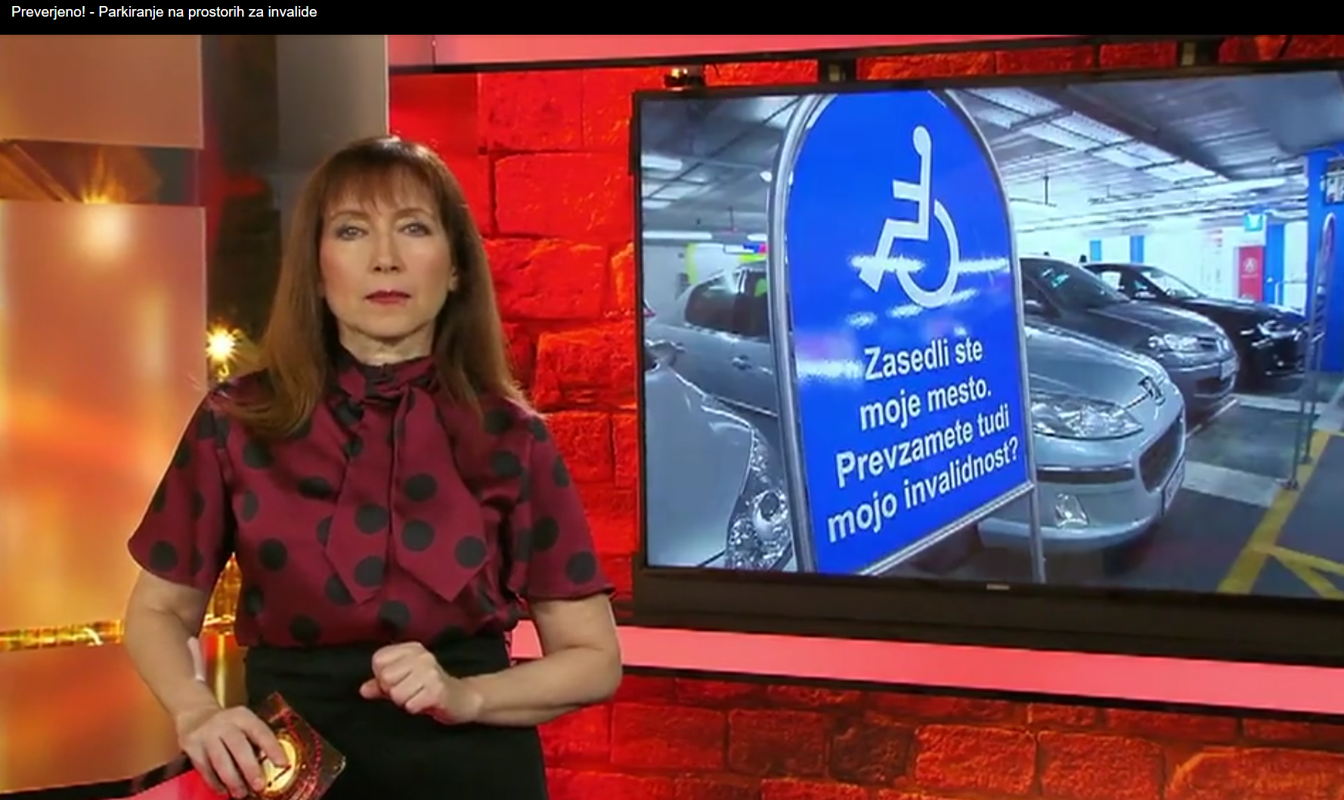
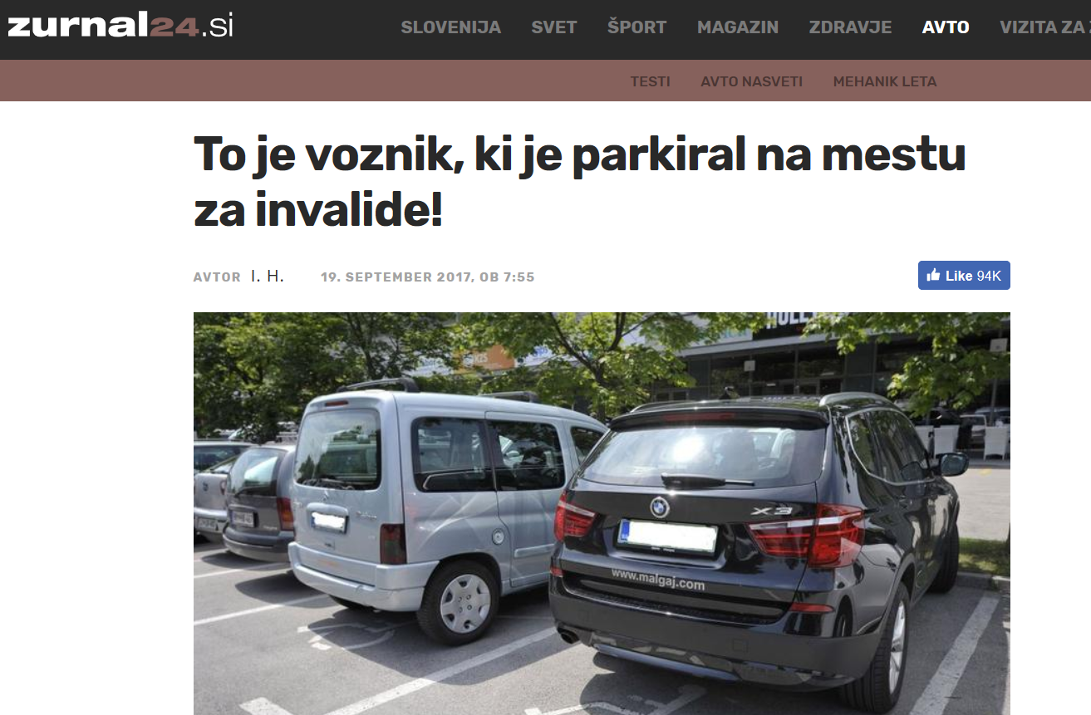
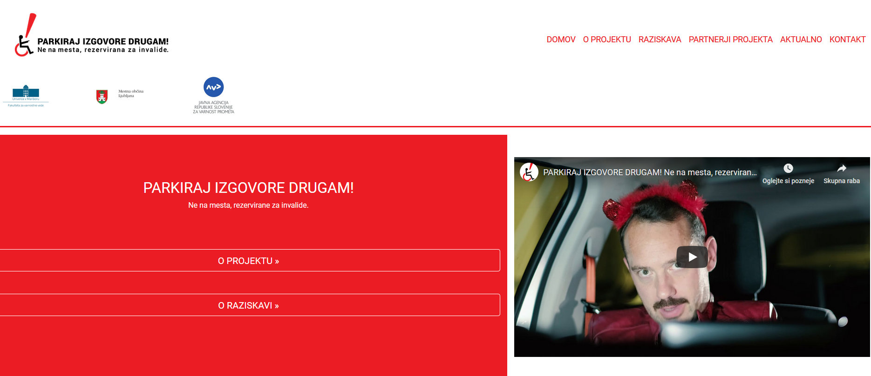
PUBLIC
AWARENESS
CAMPAIGN
OVER 100 NEWS STORIES IN ALL NATIONAL MEDIA IN SLOVENIA
Pričetek projekta - Novinarska konferenca 18. 9. 2018
http://parkiraj-izgovore.si/

Slide 22
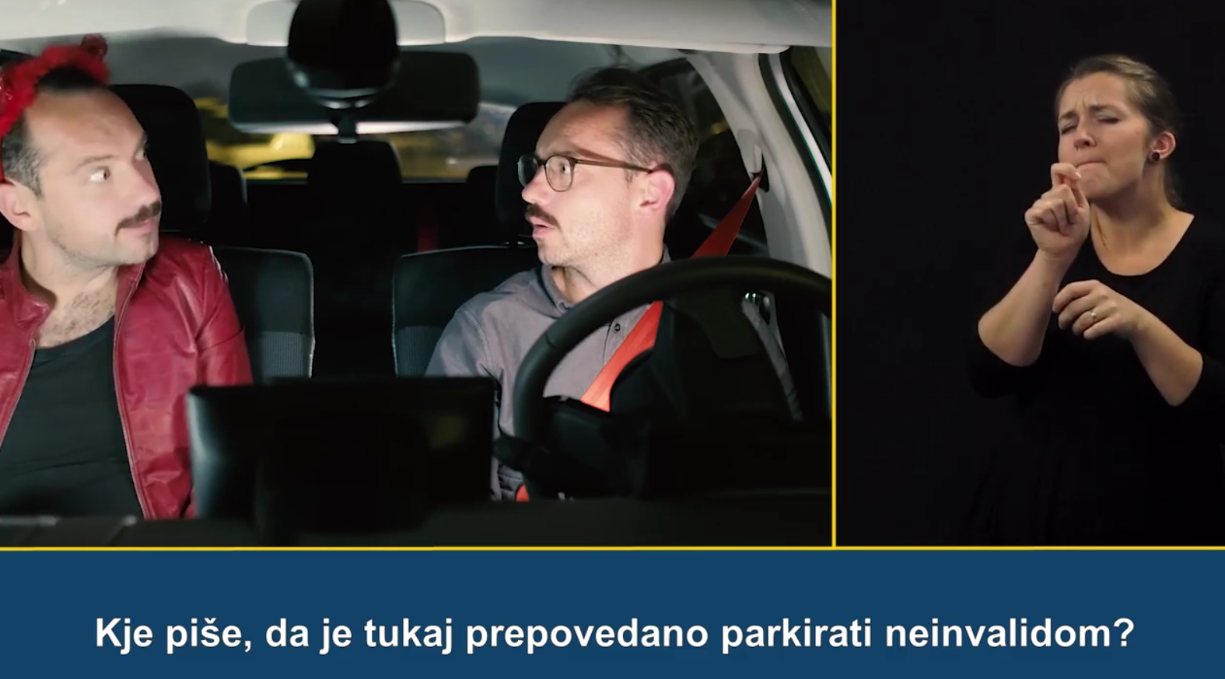
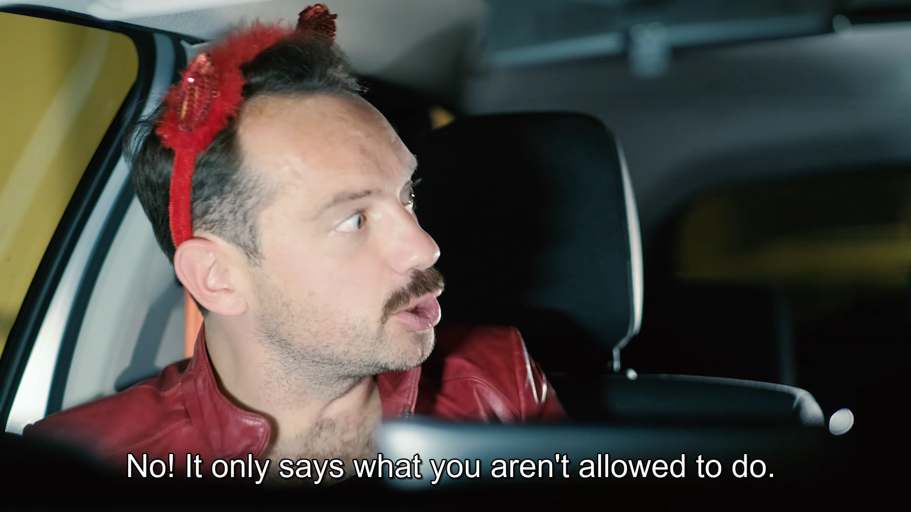
Video campaign
Video broadcasted on Slovenian national TV (december 2017-January 2018)

Slide 23
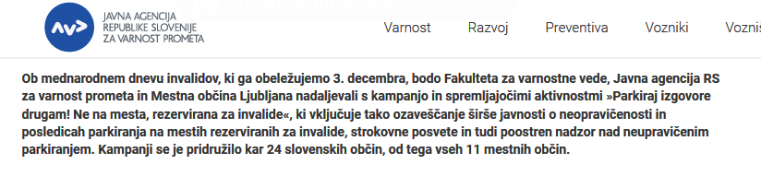
* INTENSIFIED
SURVEILLANCE

Slide 24
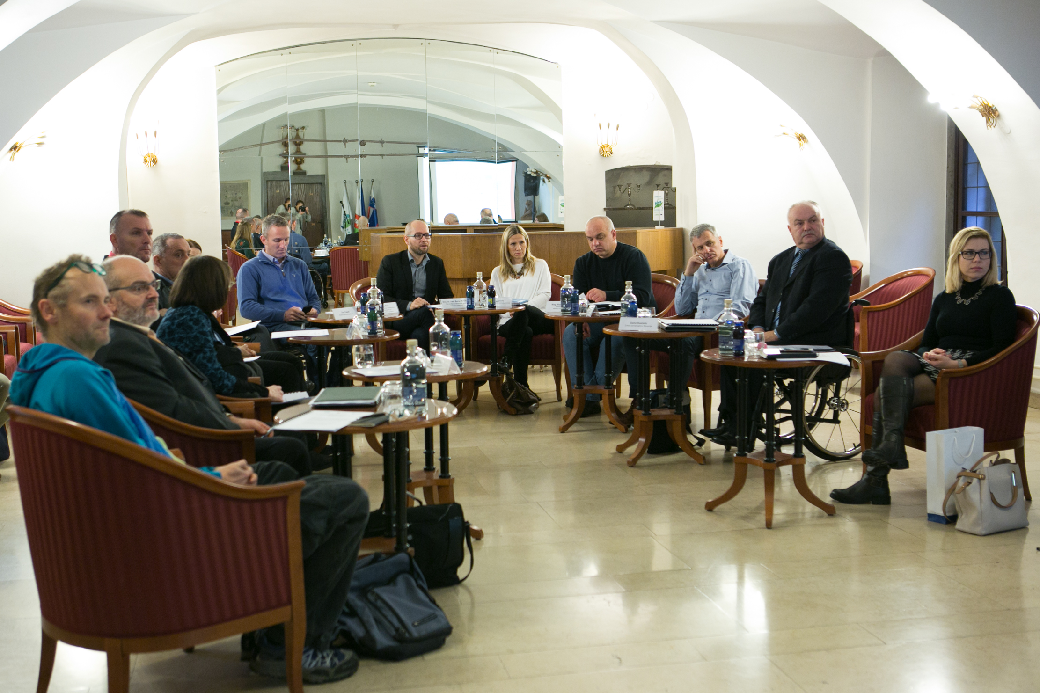
EXPERTS MEETING
Representatives of Slovenian Road Traffic Agency, the City of Ljubljana, Municipal wardens, Slovenian Police & support organizations

Slide 25
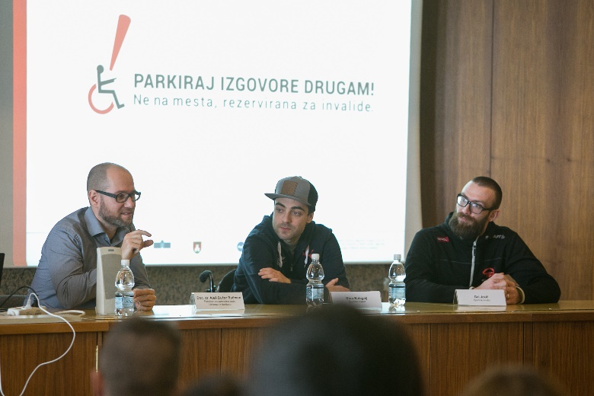
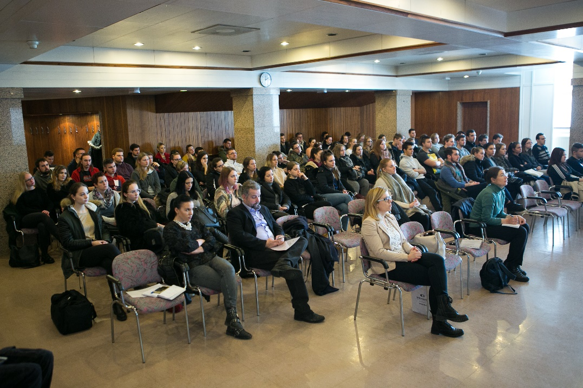
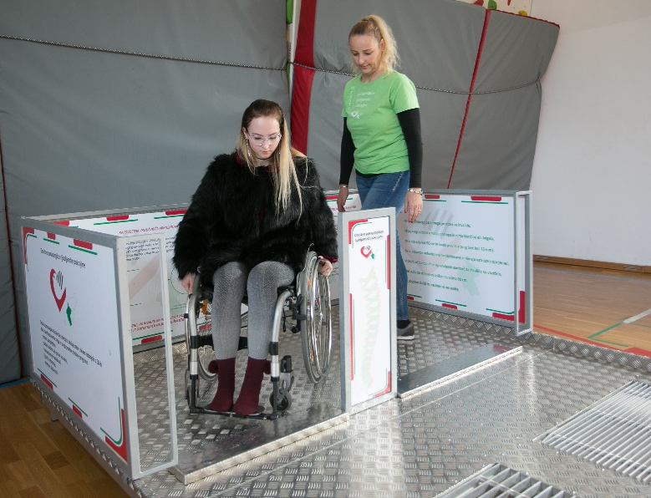
TEACHING THROUGH EXPERIENCE
Public event for young drivers & experiencing difficulties & discussion with disabled peers

Slide 26
PARK YOUR EXCUSES ELSEWHERE!
Not on spaces reserved for the disabled people.

